Slide 1


TEAM NINJAS.CO
PREDICTING LOAN DEFAULTERS
USING DATA MINING METHOD
GROUP B

Slide 2


INTRODUCTION
We know that the investors provide loans to the borrowers with the understanding that they will repay the loans with interest.
Investors come across 2 sides. One where the borrower repays the loan. In this case, the lender has profited from the interest amount. On the other side, if a borrower is unable to pay the loan, the lender will lose this money. The lenders must face the problem of predicting this risk if a borrower is unable to repay the loan back.
We will analyze historical data and predict defaulters using Decision tree and Logistic regression models. We will also check the performance of these models using evaluators and decide if any model has dominance over the other.

Slide 3




Meet our Ninjas Team
Gautham
Shetty
Thanh
Do
Abhishek
Arya
Sai Priya
Moravaneni

Slide 4

UNDERSTANDING
THE DATA SET
DATA SOURCE
FEATURES
Kaggle.com
The dataset has 9578 records and 14 attributes.

Slide 5

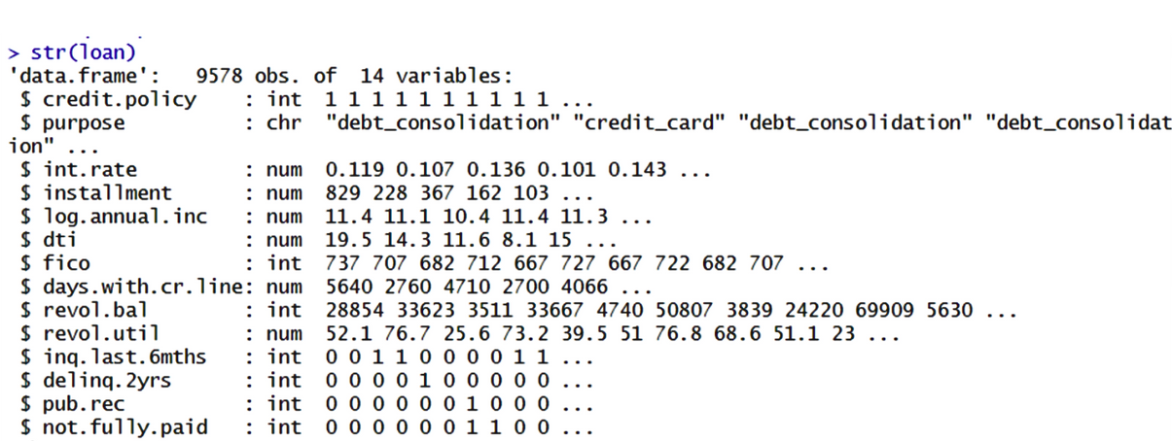
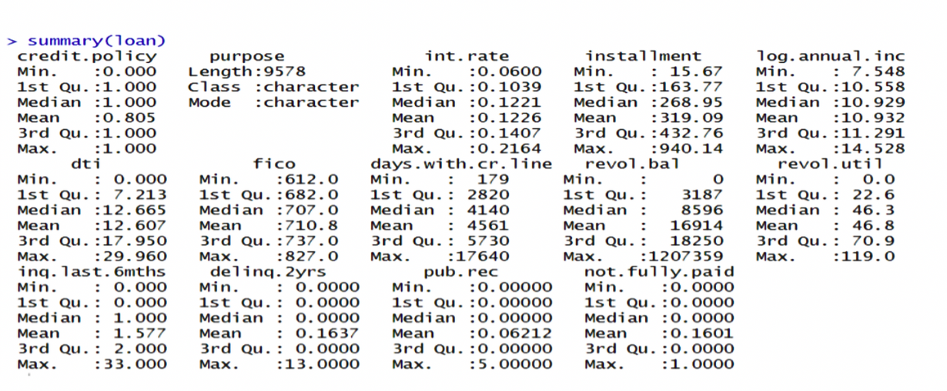
DATA EXPLORATION (EDA)
(1) Data Introduction and Description
As we can observe, this dataset has 9578 observations/records and 14 attributes/columns.
The attributes consist of 7 variables in int, 6 variables in num, 1 variable in char.
As we can observe, “purpose” variable is a categorical variable and hence we are not getting the summary, to get some idea about this variable’s summary, we can convert it to factor class.

Slide 6

DATA EXPLORATION (EDA)
(2) Each Variable Statistics
Variables
Definition
Mean
Std. Dev
Min
Max
This is the dependent variable which indicates if the loan was paid back to the lender by the borrower in full or not (borrower can either be marked as default or the borrower was unlikely to pay it back)
not.fully.paid
0.1601
0.3666755
0
1
credit.policy
If the customer meets the credit underwriting criteria of LendingClub.com, and 0 otherwise. This is based on an evaluation done by the lending entity as per lending protocols
0
1
0.805
0.3962447
purpose
The purpose of loan (can be ‘credit_card’, ‘educational’,'major_purchase’,’small_business’,’debt_consolidation’,’all_other’, ’home improvement’)
1
2.944
7
1.688
int.rate
The interest rate of the loan, as a proportion (a rate of 11% would be stored as 0.11). Borrowers judged by LendingClub.com to be riskier are assigned higher interest rates.
0.1226
0.06
0.2164
0.02684699
installment
The monthly installments ($) owed by the borrower if the loan is funded.
319.09
207.0713
15.67
14.528

Slide 7
DATA EXPLORATION (EDA)
Variables
Definition
Mean
Std. Dev
Min
Max
log.annual.inc
The natural log of the self-reported annual income of the borrower
10.932
0.6148128
7.548
14.528
dti
The debt-to-income ratio of the borrower (amount of debt divided by annual income)
12.607
6.88397
0
29.960
fico
The FICO credit score of the borrower. A FICO Score is a three-digit number based on the information in one's credit reports
710.8
37.97054
612.0
827.0
days.with.cr.line
The number of days the borrower has had a credit line
4561
2496.93
179
17640
revol.bal
The borrower's revolving balance (amount unpaid at the end of the credit card billing cycle)
16914
33756.19
0
1207359

Slide 8
DATA EXPLORATION (EDA)
Variables
Definition
Mean
Std. Dev
Min
Max
revol.util
The borrower's revolving line utilization rate (the amount of the credit line used relative to total credit available)
46.8
29.01442
0
119.0
inq.last.6mths
The borrower's number of inquiries by creditors in the last 6 months
1.577
2.200245
0
33.0
delinq.2yrs
The number of times the borrower had been 30+ days past due on a payment in the past 2 years
0.1637
0.5462149
0
13.0
pub.rec
The borrower's number of derogatory public records (bankruptcy filings, tax liens, or judgments)
0.06212
0.2621263
0
5.0

Slide 9

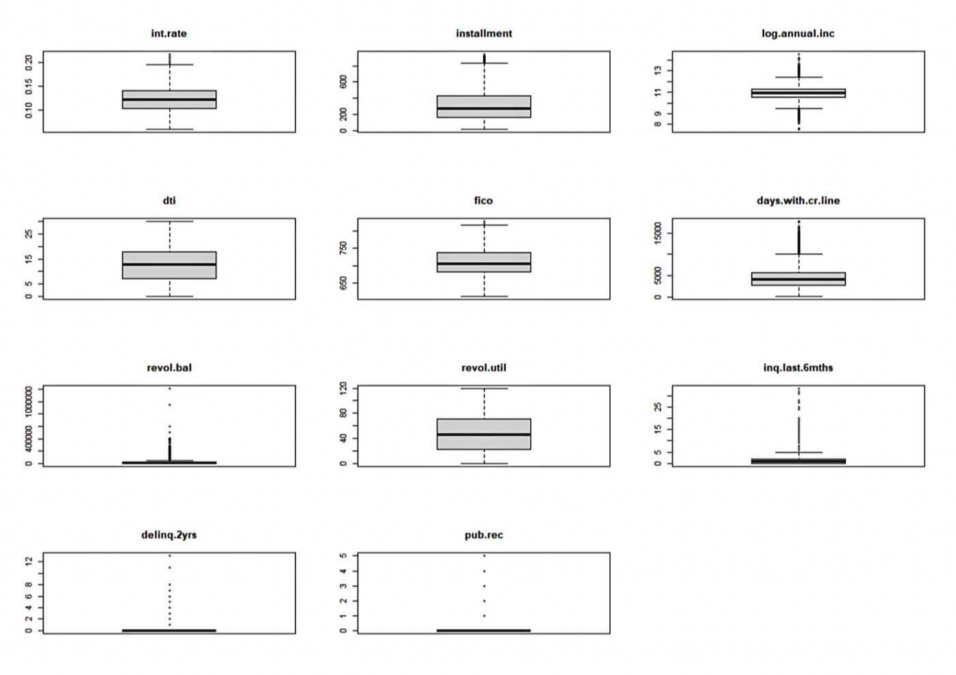
DATA EXPLORATION (EDA)
(3) Outlier Detectionby using Box Plot

Slide 10
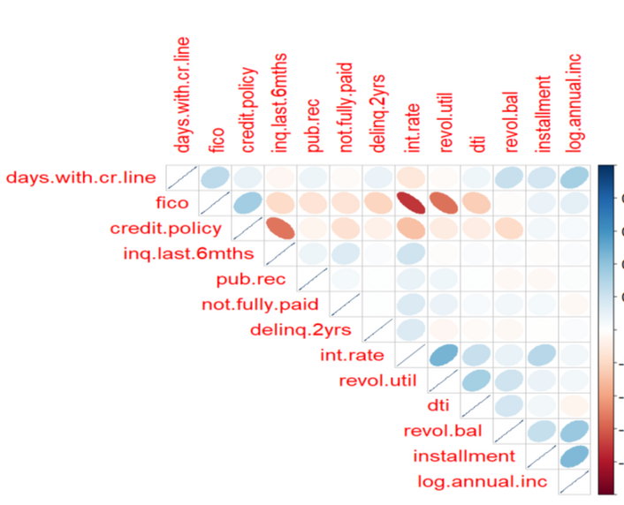
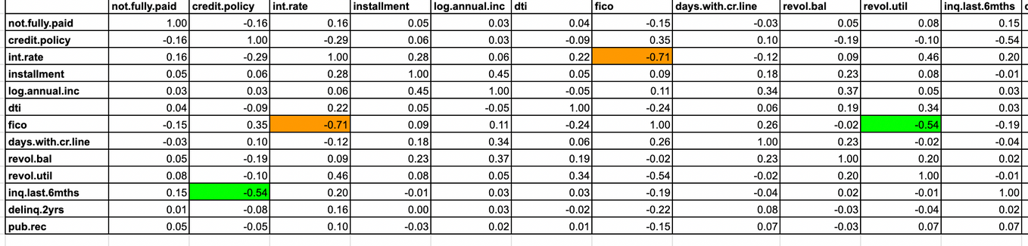
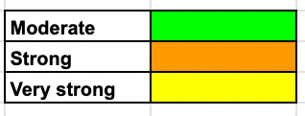
DATA EXPLORATION (EDA)
(4) Correlation Matrix between variables

Slide 11
DATA EXPLORATION (EDA)
(5) Independent Vars. Specifications
Focal dependent variable :
not.fully.paid depends on almost all the independent variables with high correlation and significance of installment, revol.bal, inq.last6months, fico, log.annual.inc, int.rate, credit.policy independent variables.

Slide 12

[CLASSIFICATION] DECISION TREE
(1) Splitting the data into training and test data
# we will first randomly select 2/3 of the rows
>set.seed(345)
>train=sample(1:nrow(loandata),nrow(loandata)*(2/3))
# Use the train index set to split the dataset
> loandata.train = loandata[train,]
> loandata.test = loandata[-train,]
# Grow tree
>fit = rpart(not.fully.paid ~.,data=loandata.train,method="class",control=rpart.control(maxdepth = 4,minsplit=10, minbucket = 3, cp=0.002),parms=list(split="gini"))

Slide 13
[CLASSIFICATION] DECISION TREE
(2) Growing a tree and display basic results
> f﻿it
n= 6385
node), split, n, loss, yval, (yprob)
* denotes terminal node
1) root 6385 1046 0 (0.83617854 0.16382146)
2) credit.policy>=0.5 5137 696 0 (0.86451236 0.13548764)
4) int.rate< 0.1118 1897 153 0 (0.91934634 0.08065366) *
5) int.rate>=0.1118 3240 543 0 (0.83240741 0.16759259)
10) int.rate< 0.19315 3220 532 0 (0.83478261 0.16521739)
20) installment< 879.885 3201 521 0 (0.83723836 0.16276164) *
21) installment>=879.885 19 8 1 (0.42105263 0.57894737) *
11) int.rate>=0.19315 20 9 1 (0.45000000 0.55000000)
22) purpose=credit_card,debt_consolidation,home_improvement 8 2 0 (0.75000000 0.25000000) *
23) purpose=all_other,small_business 12 3 1 (0.25000000 0.75000000) *
3) credit.policy< 0.5 1248 350 0 (0.71955128 0.28044872)
6) purpose=credit_card,debt_consolidation,major_purchase 691 159 0 (0.76989870 0.23010130) *
7) purpose=all_other,educational,home_improvement,small_business 557 191 0 (0.65709156 0.34290844)
14) installment< 374.765 427 131 0 (0.69320843 0.30679157) *
15) installment>=374.765 130 60 0 (0.53846154 0.46153846)
30) fico>=689.5 73 25 0 (0.65753425 0.34246575) *
31) fico< 689.5 57 22 1 (0.38596491 0.61403509) *

Slide 14
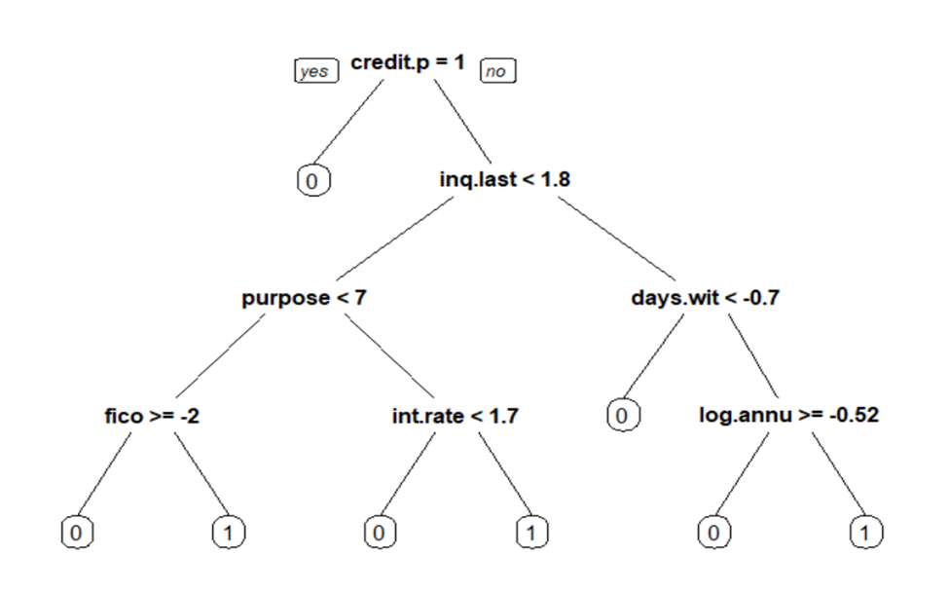
[CLASSIFICATION] DECISION TREE
(3) Plotting a tree and make an interpretation
> install.packages('rpart.plot')
> library(rpart.plot)
> rpart.plot(fit, type = 1, extra = 1)
Summary:
TP=11+9+35=55
FP=8+3+22=33
TN=1744+296=2040
FN=153+131=284
# extract the vector of predicted class for each observation in loandata.train
> loandata.pred <- predict(fit, loandata.train, type="class")
# extract the actual class of each observation in loandata.train
> loandata.actual <- loandata.train$not.fully.paid
# now build the confusion matrix
# which is the contingency table of predicted vs actual
> confusion.matrix <- table(loandata.pred, loandata.actual)
> confusion.matrix
loandata.actual
loandata.pred 0 1
0 5306 991
1 33 55

Slide 15
[CLASSIFICATION] DECISION TREE
(4) Accuracy on the training data
(5) Accuracy on the testing data
> loandata.pred <- predict(fit, loandata.train, type="class")
> loandata.actual <- loandata.train$not.fully.paid
> confusion.matrix <- table(loandata.pred, loandata.actual)
> pt<-prop.table(confusion.matrix)
> pt[1,1] + pt[2,2]
[1] 0.8396241
> loandata.pred <- predict(fit, loandata.test, type="class")
> loandata.actual <- loandata.test$not.fully.paid
> confusion.matrix <- table(loandata.pred, loandata.actual)
> confusion.matrix
loandata.actual
loandata.pred 0 1
0 2678 471
1 28 16
> pt<-prop.table(confusion.matrix)
> pt[1,1] + pt[2,2]
[1] 0.8437206

Slide 16
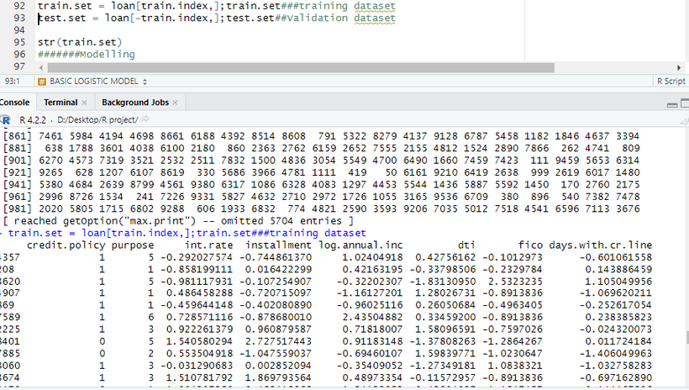
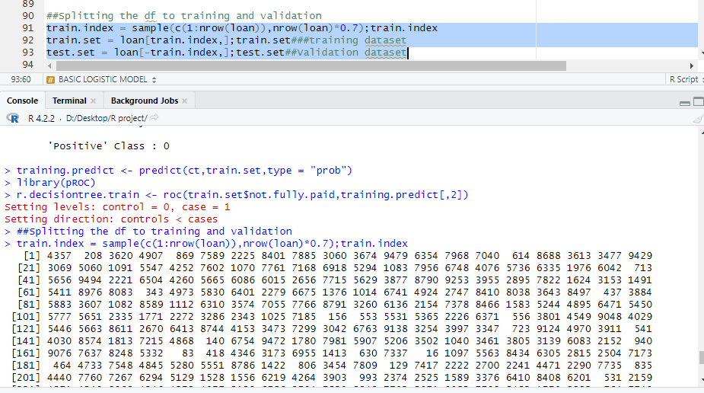
[CLASSIFICATION] LOGISTIC REGRESSION
(1) Splitting the data into training and test data
#Splitting the df to training and validation
train.index = sample(c(1:nrow(loan)),nrow(loan)*0.7)
train.set = loan[train.index,]###training dataset
valid.set = loan[-train.index,]##Validation dataset
str(train.set)

Slide 17
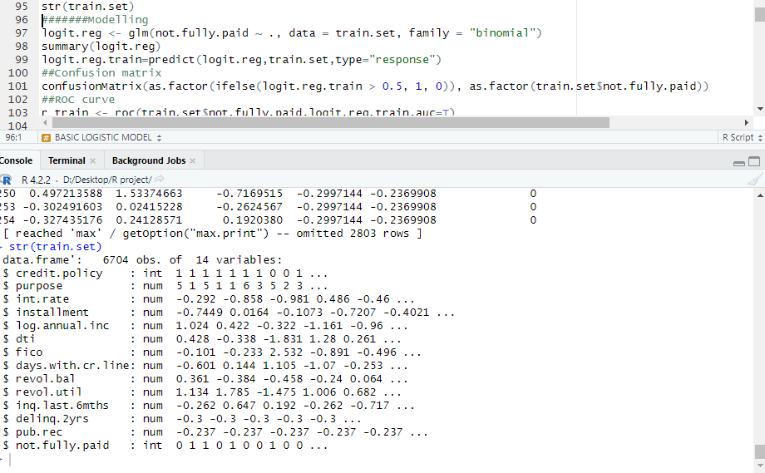
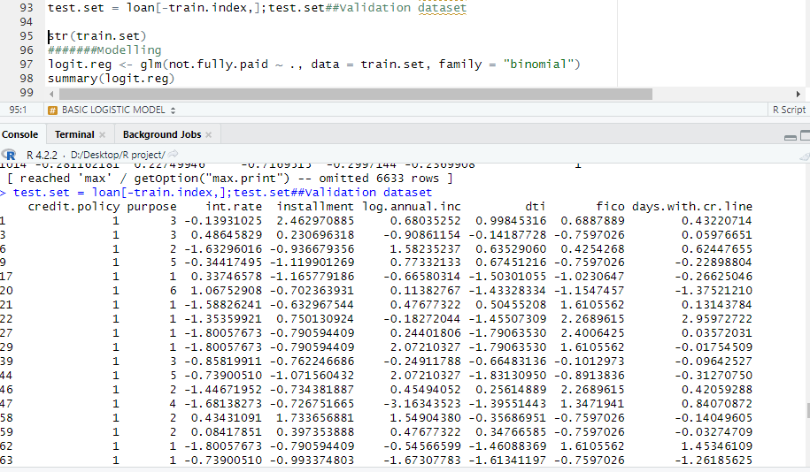
[CLASSIFICATION] LOGISTIC REGRESSION
(2) Logistic regression and display the result

Slide 18
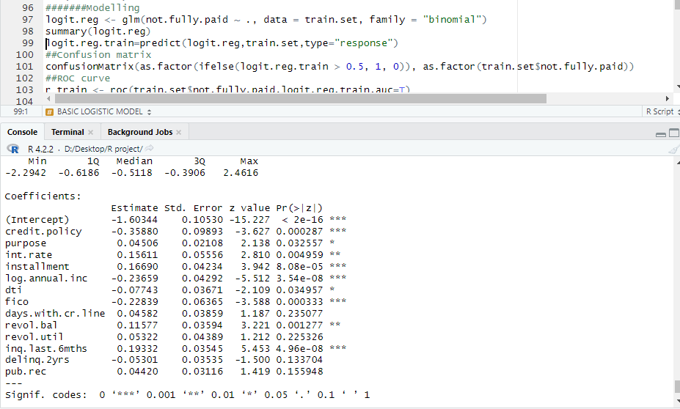
[CLASSIFICATION] LOGISTIC REGRESSION
(3) Interpretation of significancy and coefficient
Our Findings from models
As per the output of the decision tree model two independent variables Revol.bal and instalment are not significant variable for the focal dependent variable ie Not fully paid but In case of logistic regression model we can say that revol.bal. and instalment are very important and significant variables for determining the dependent variable.
For every one unit increase in instalment increase the chance of default by 1.181 or 18% increase in not fully paid . While for every one unit increase in revol.bal. Increase the chance of default or not fully paid by 1.122 or 12.2%
For instalment e^ 0.16690 = 1.181
For revol.bal. e^ 0.11577 = 1.122

Slide 19
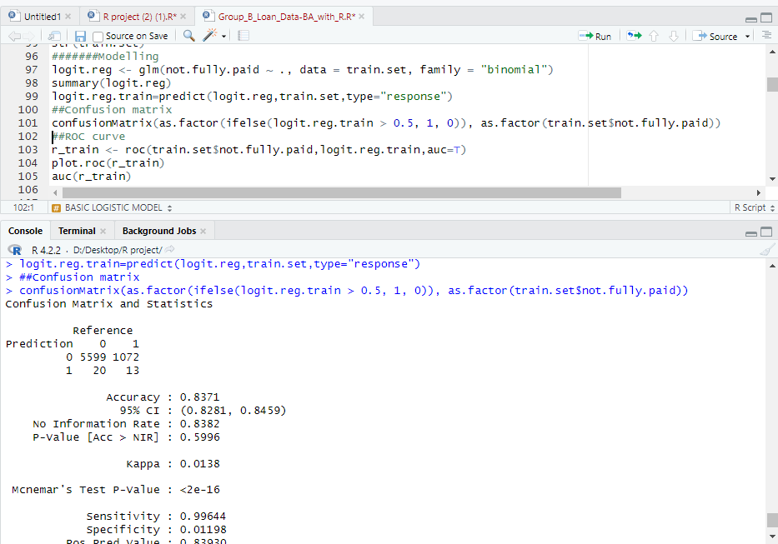
[CLASSIFICATION] LOGISTIC REGRESSION
(4) Accuracy on the training data
After finding the confusion matrix the accuracy is 83.71%

Slide 20
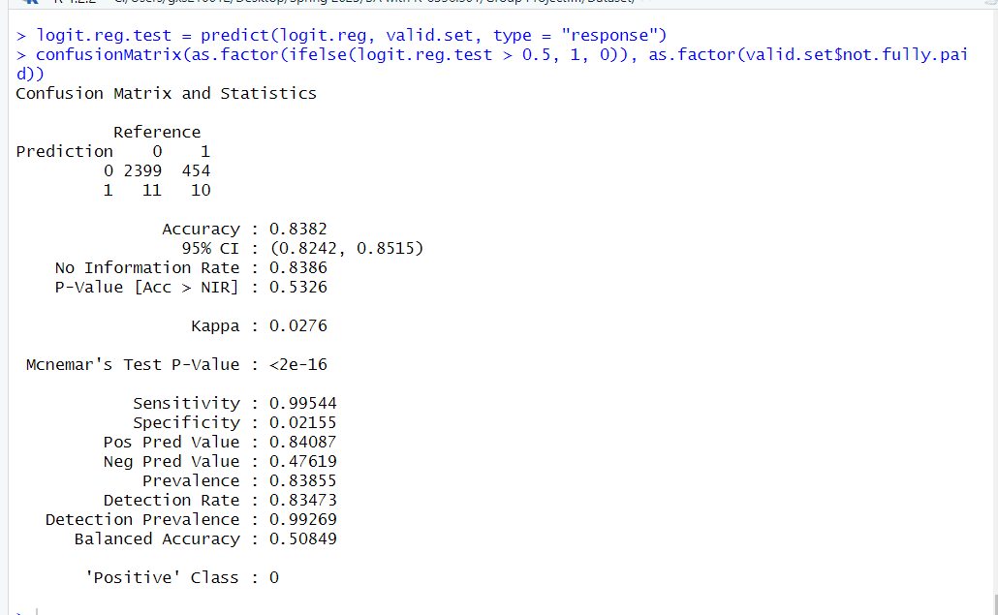
[CLASSIFICATION] LOGISTIC REGRESSION
(5) Accuracy on the test data
After finding the confusion matrix the accuracy is 83.82%

Slide 21


CONCLUSION
From a business perspective, we can say that the loan borrowers with high income and high FICO scores are more likely to pay the loan back.
In addition, those with proper financial grounds are also likely to pay the loan back.
Borrowers with low interest rate and small installments are likely to pay the loan back fully.
Finally, the mean borrowers with high interest rates and high installment can be a potential defaulters.
NINJAS.CO

